Slide 1
Web services programming Project Presentation --Ecommerce
Jung-ju(Sonia) Lin
Jianshi Yuan
Ting Liu
2016-12-06
1

Slide 2
Agenda
Project Overall Idea
Project Architecture
Implementation
Difficulties and Lessons

Slide 3
Project Overall Idea
A online purchasing platform for customers
- Customer sign up and login
- Search product
- Buy product
- Check order status
- Cancel order
Order/inventory management platform for partners
- Register and create profile of partners
- Add products in market place
- Get acknowledgement of order fulfillment
- Ship order

Slide 4
Project Overall Idea
State diagram (customer)
Search product
Home
(product listing – minimal actions enabled)
Log in
Home
(product listing)
View product details (hypermedia link used)
Buy product (hypermedia link available)
Check orders
Order listing
Cancel order
(hypermedia link available)

Slide 5
Project Overall Idea
State diagram (partner)
Search product
Home
(product listing – minimal actions enabled)
Log in
Home
(product listing)
View product details (hypermedia link used)
Add product (hypermedia link available)
Check orders
Order listing
Ship order
(hypermedia link available)

Slide 6
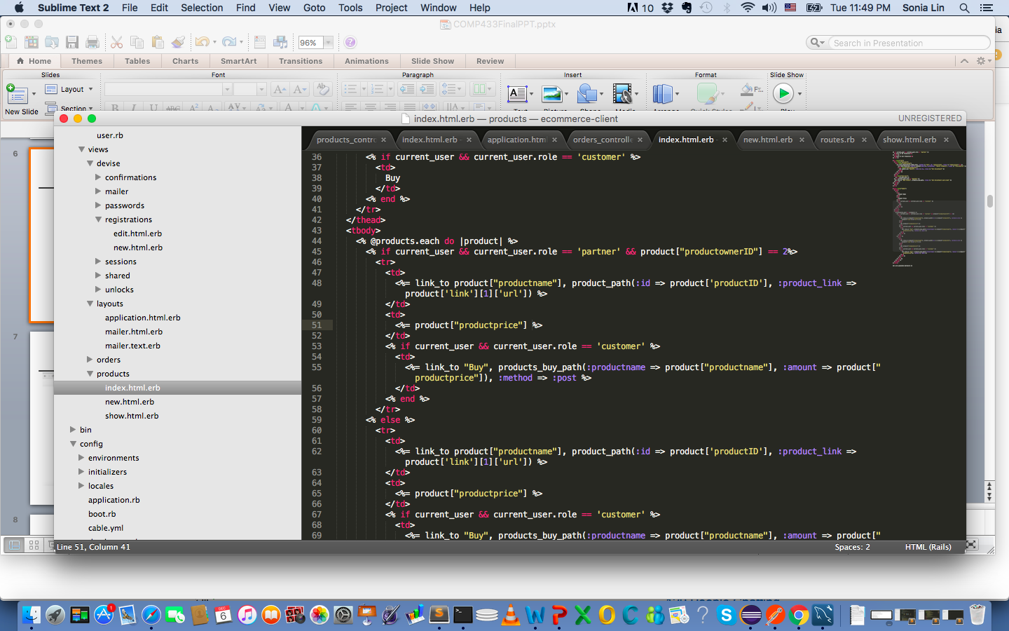
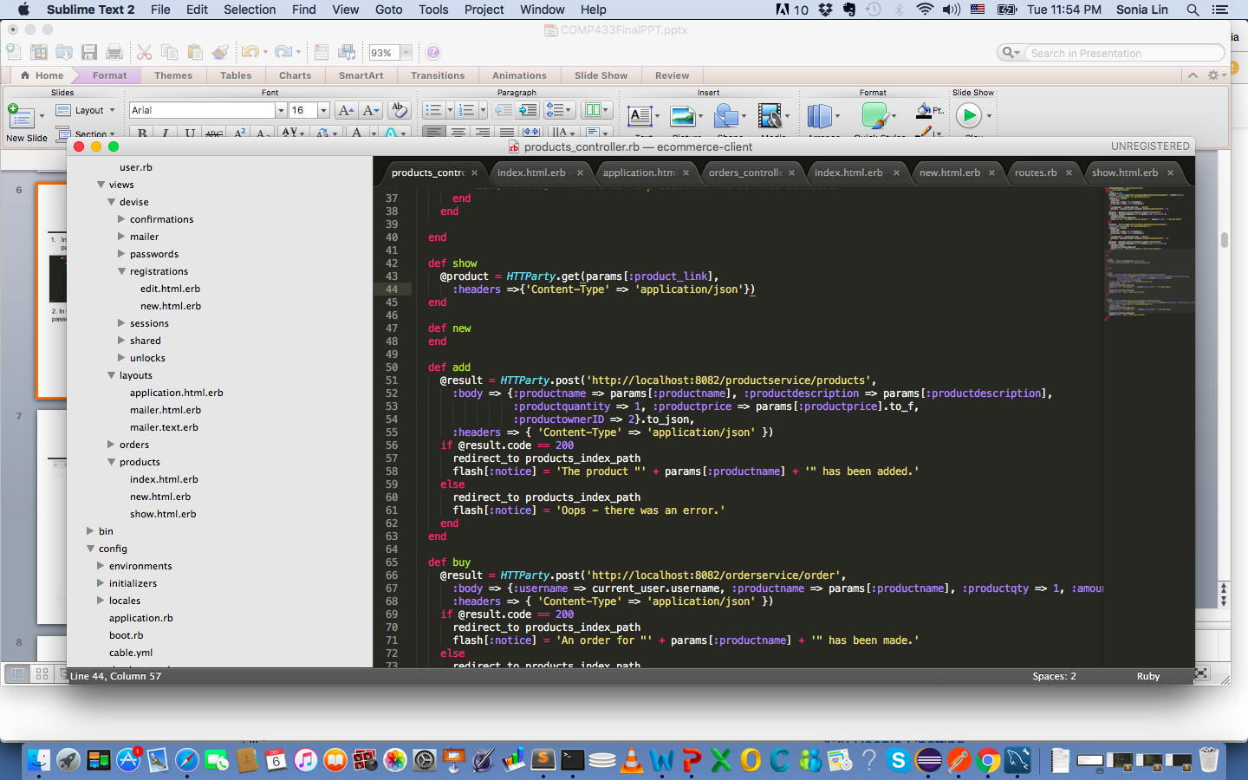
Hateoas Usage Explained (product details page)
In the product listing page view: The value of the url for the product is extracted, being passed as a parameter to the controller
2. In the product details page controller: The value of the url for the product passed in as a param from the view to the parser for single product retrieval

Slide 7
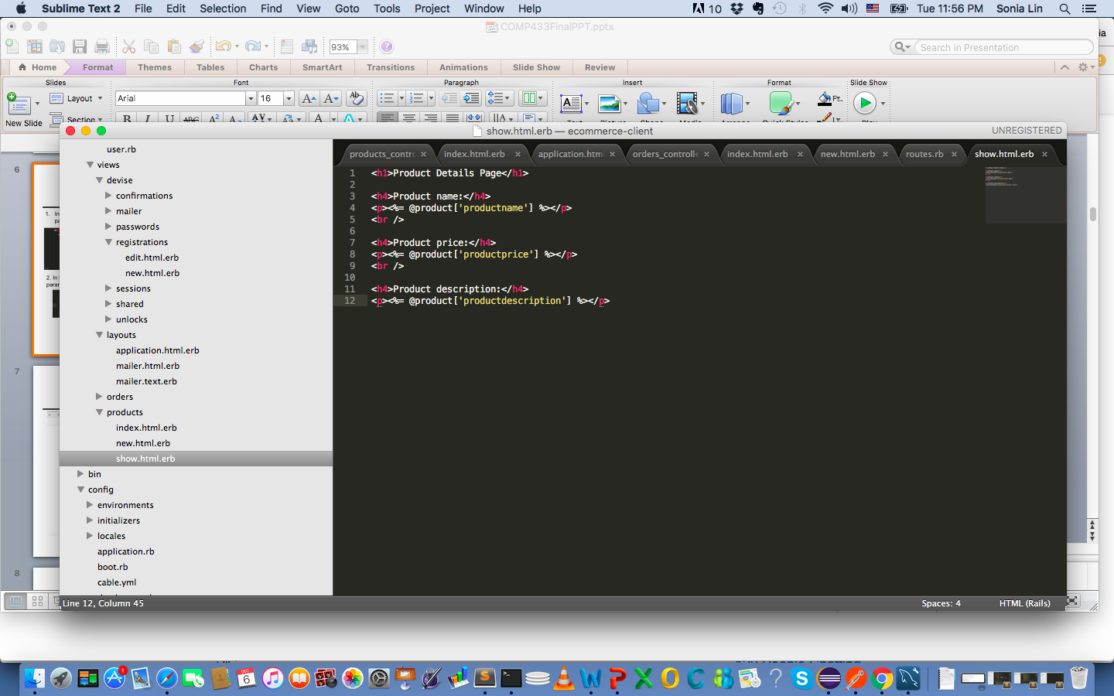
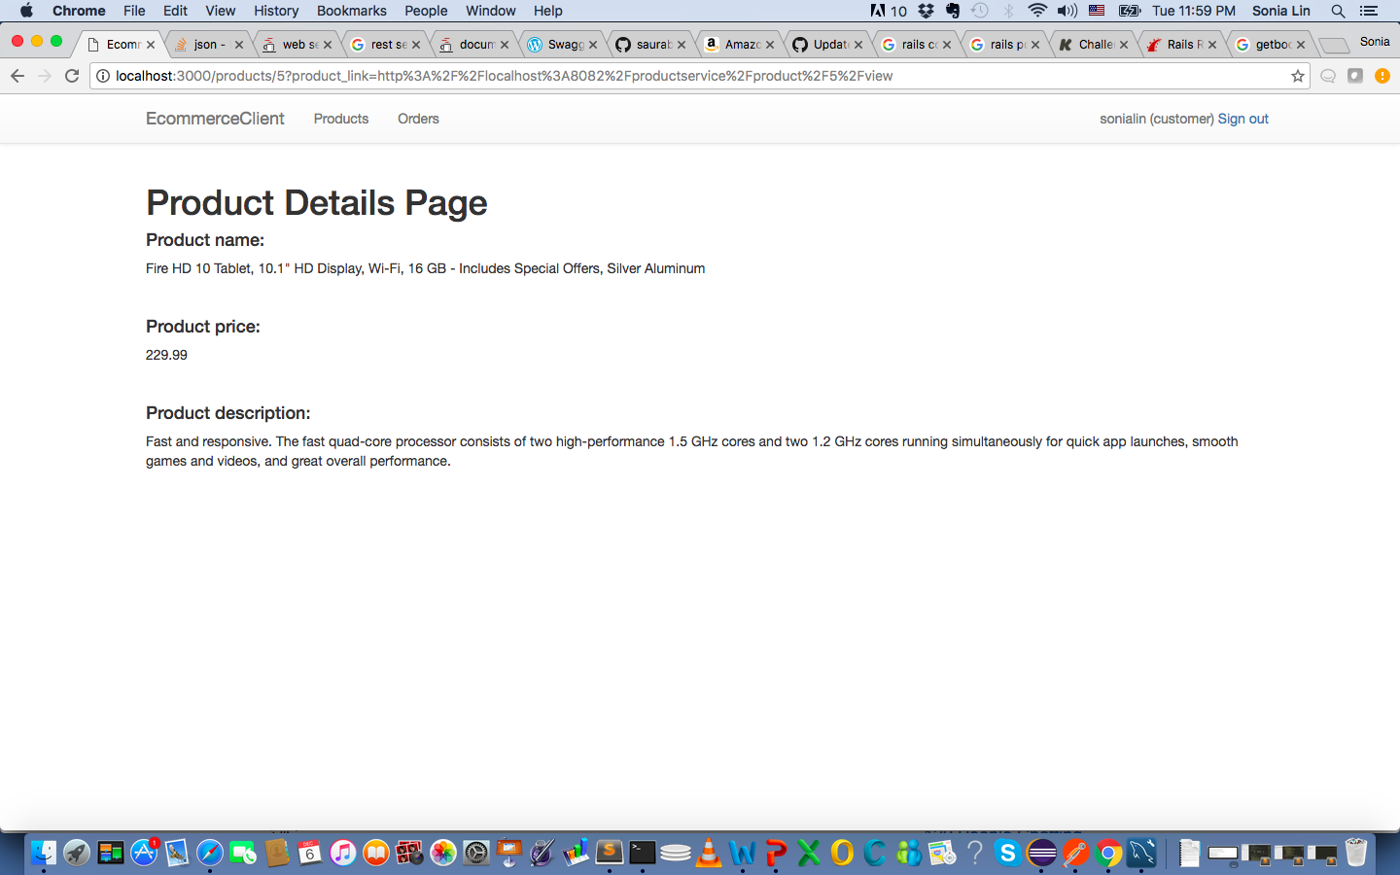
Hateoas Usage Explained (product details page)
3. In the product details page view: The response retrieved from the parser gets extracted into individual product fields

Slide 8
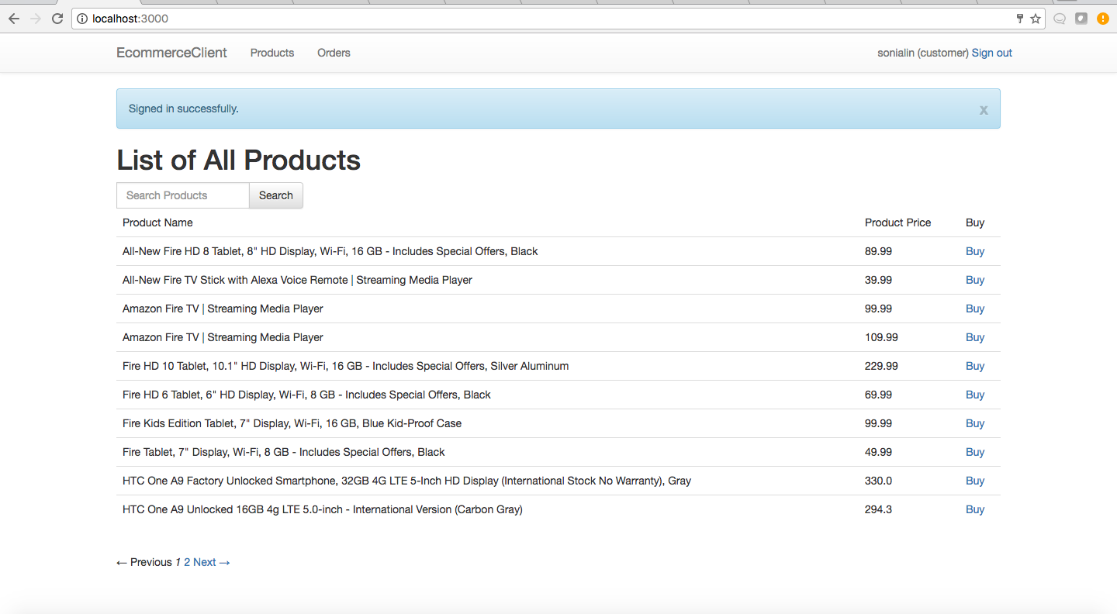
Product Listing – customer’s user story

Slide 9
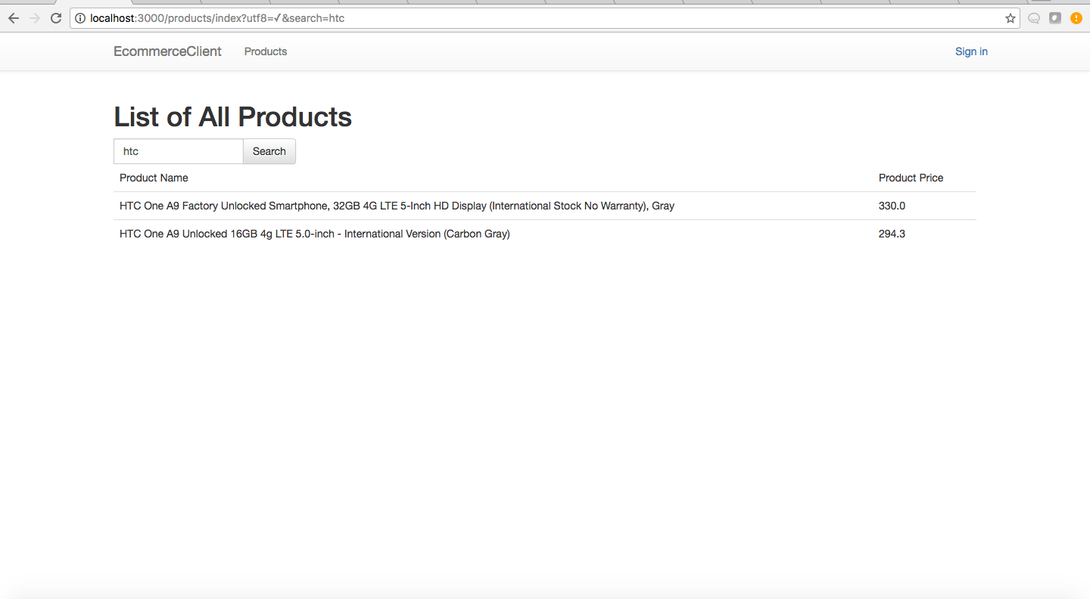
Product Search

Slide 10
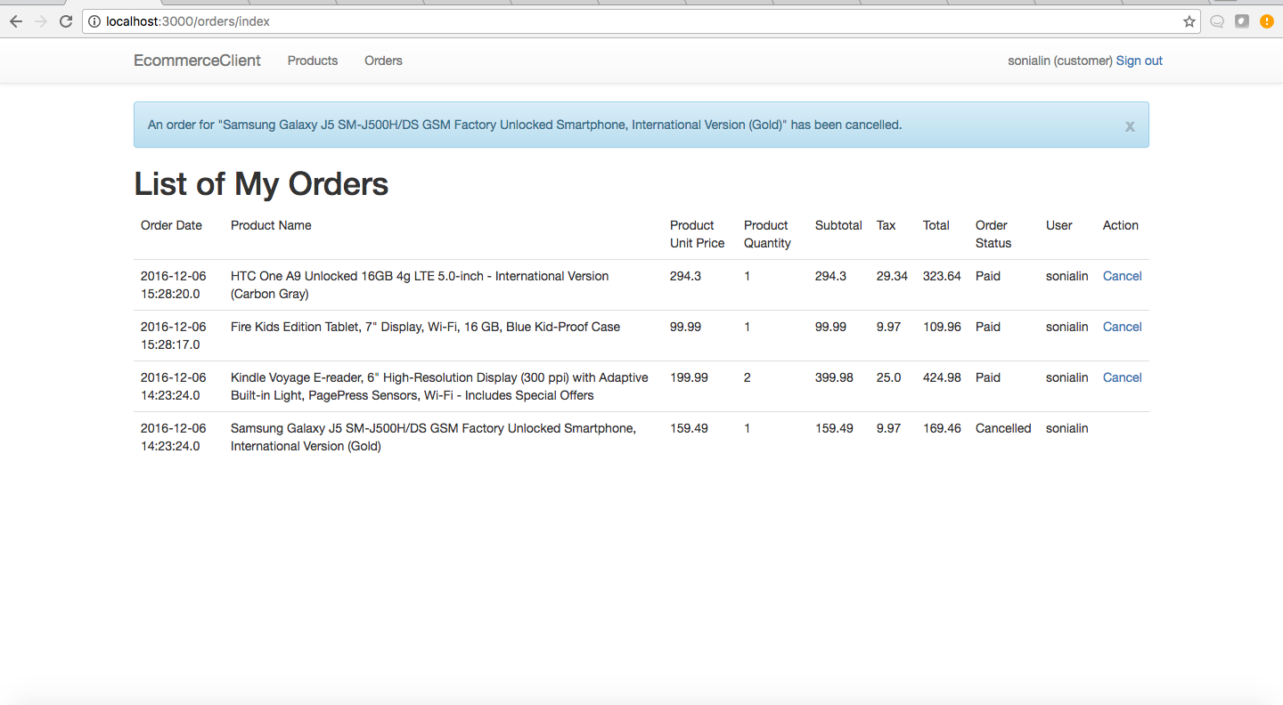
Order Listing – customer’s user story

Slide 11
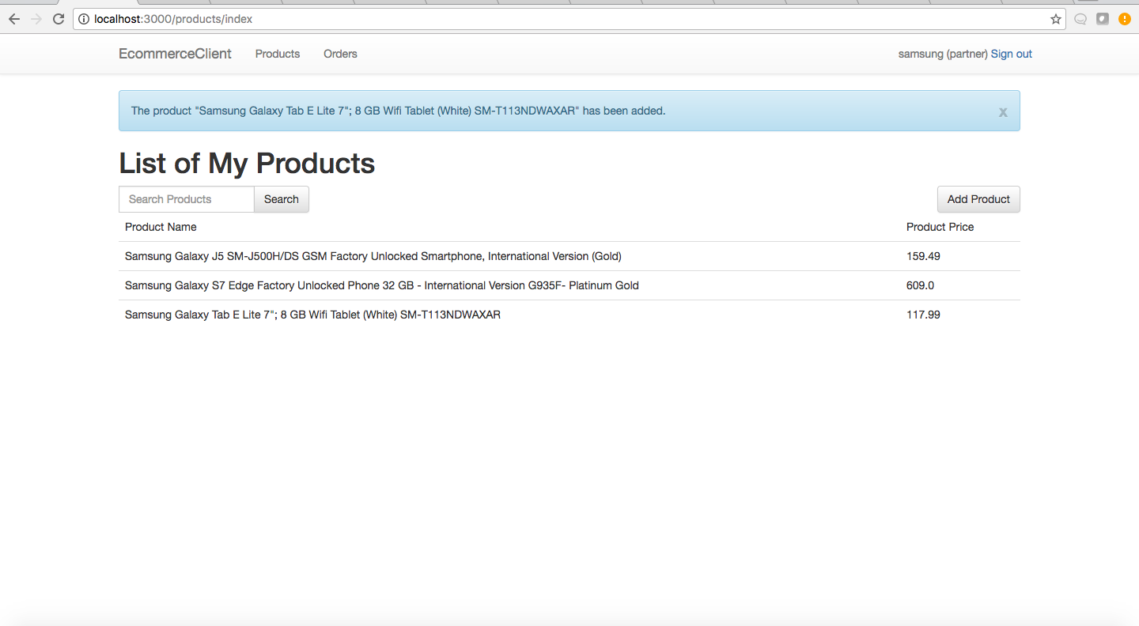
Product Listing – partner’s user story

Slide 12
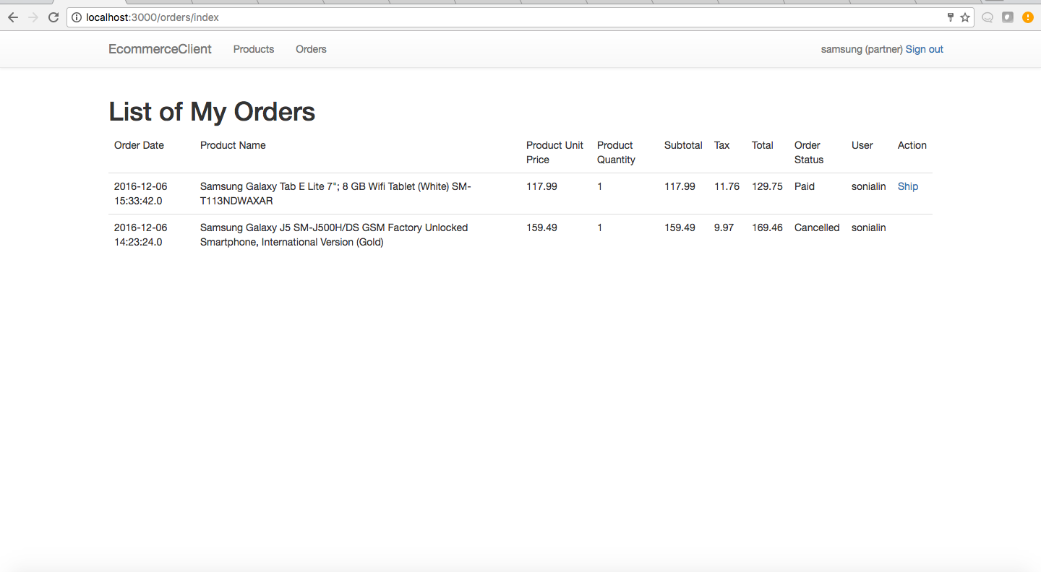
Order Listing – partner’s user story

Slide 13
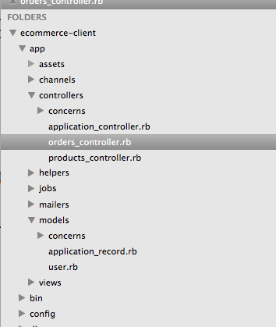
Project Architecture
Client-side structure
MVC
Order and product controllers to handle the business logic of the resource retrieval
User model for authentication

Slide 14
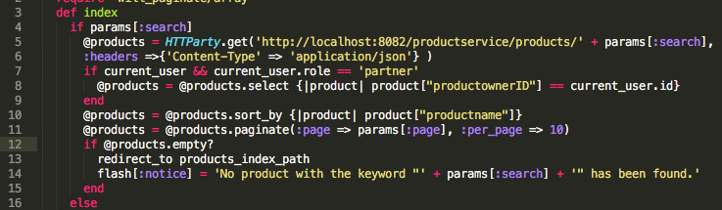
API Consumption Notes
What operations to do locally vs remotely when listing resources
a. get/search products, get orders: remote
b. Sorting, filtering, and paginating the listing are done locally (that are potentially services that can be provided)
a
b

Slide 15
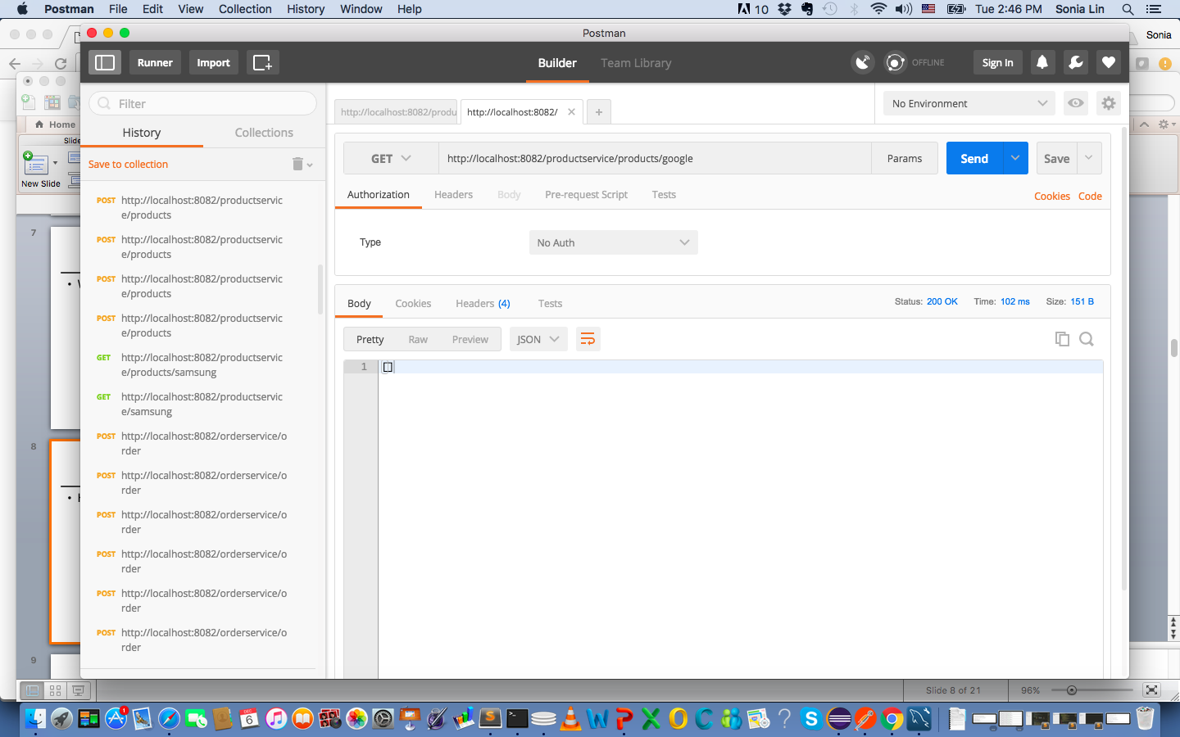
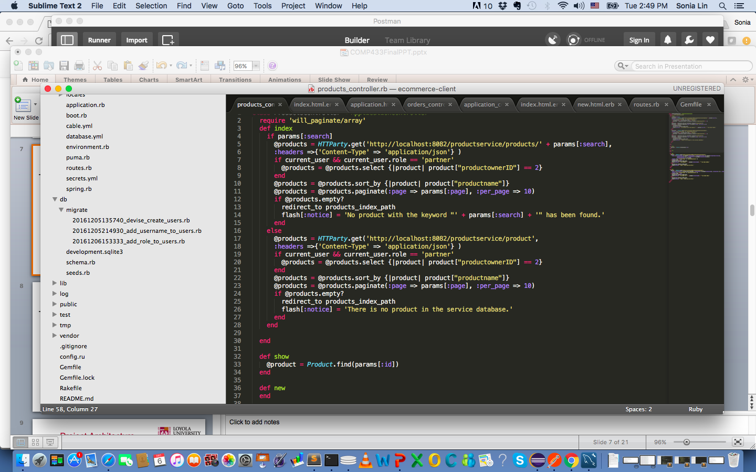
API Consumption Notes
Handle success and exception
500 (or 5xx): Server’s fault
400 (or 4xx): Client’s fault
200 (or 2xx): Success, even with no returned object (searchProduct for example)
Return empty array? No problem.
Client can handle it.

Slide 16
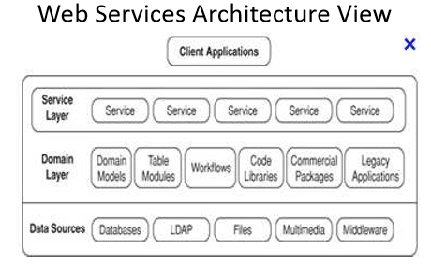
Project Architecture

Slide 17
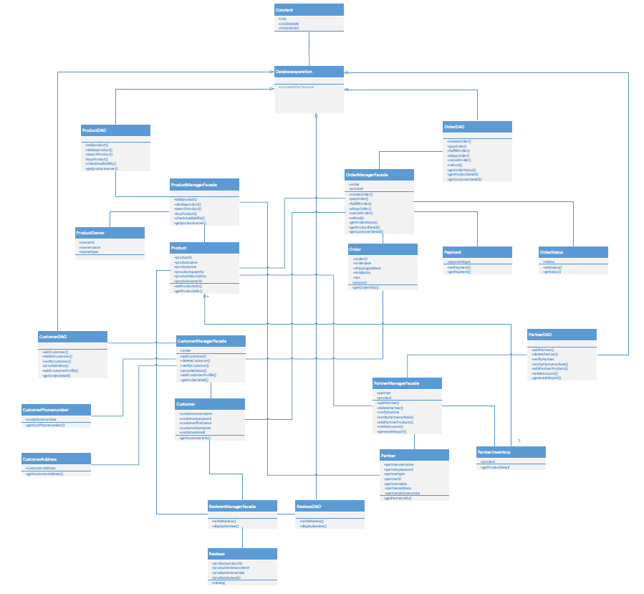
Project Architecture
UML Diagram

Slide 18
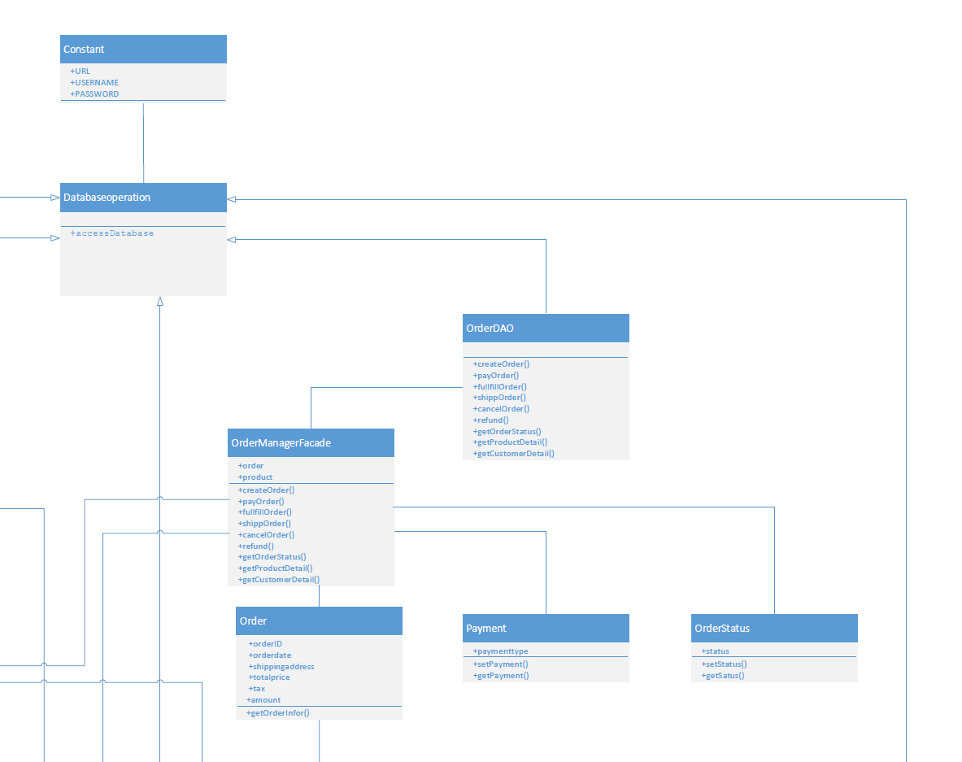
Project Architecture

Slide 19
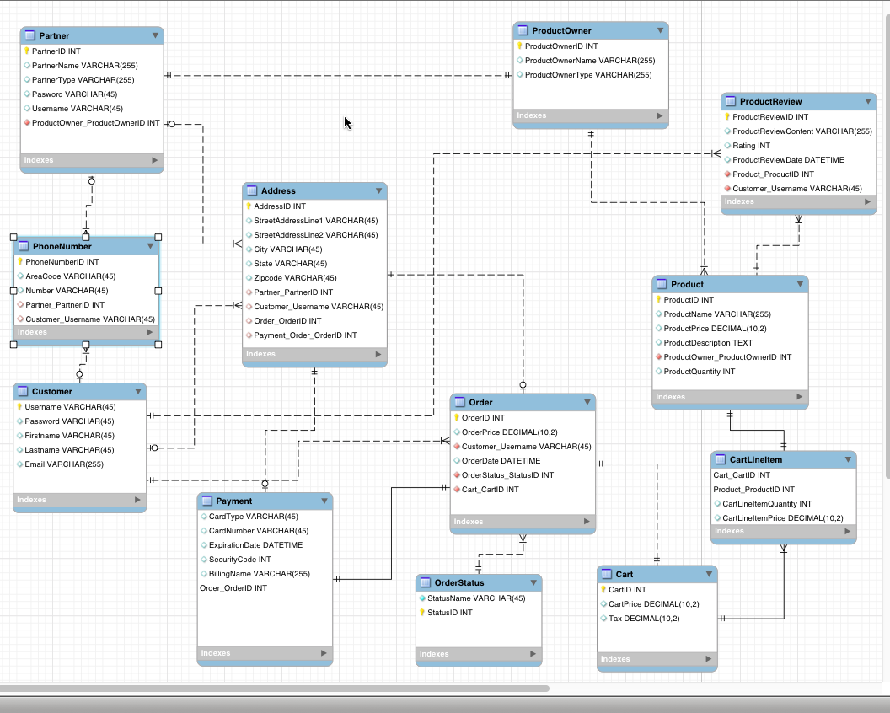
Project Architecture
Database ER diagram
Sample ddl

Slide 20
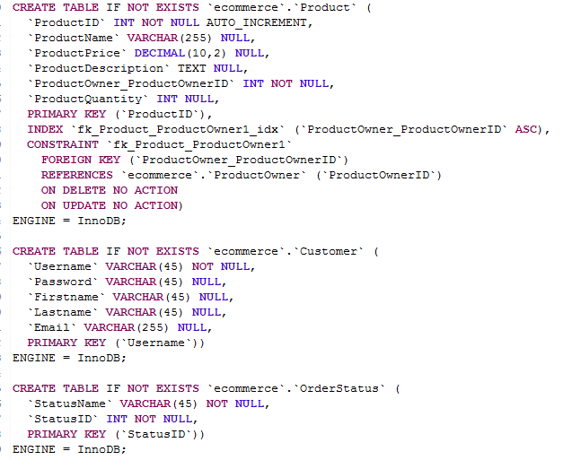
Project Architecture

Slide 21
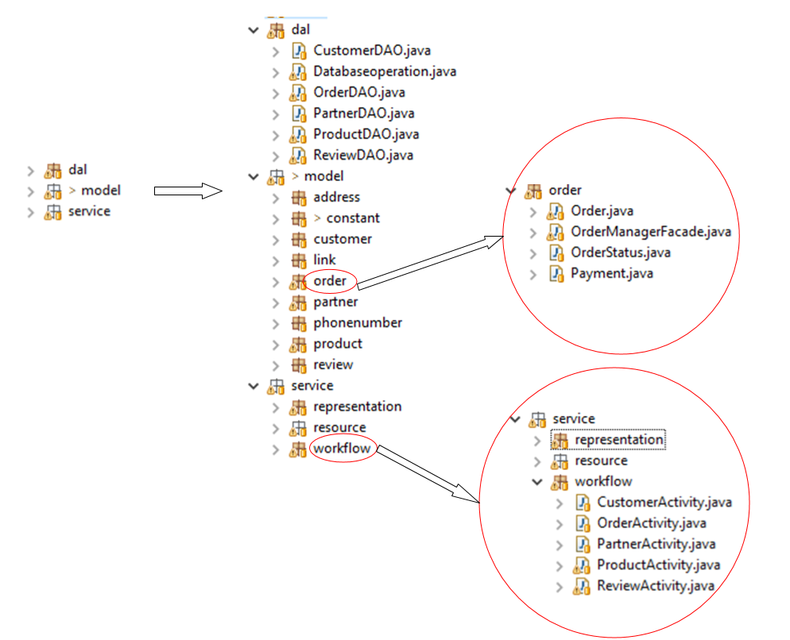
Project Architecture
Server-side structure

Slide 22
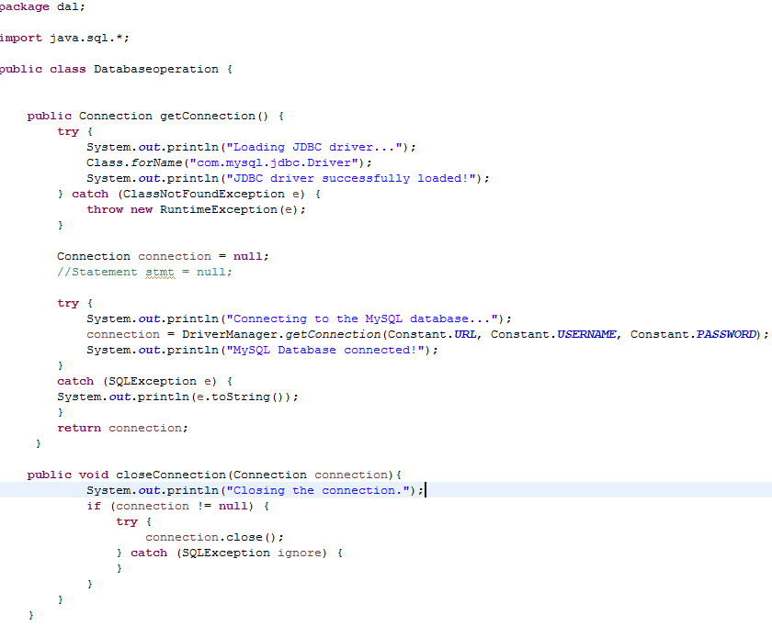
Implementation
Use JDBC to access database

Slide 23
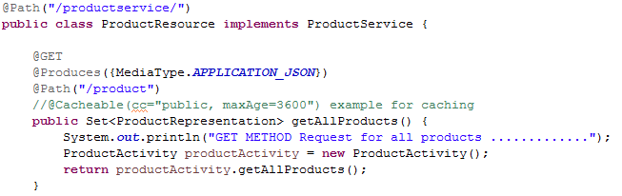
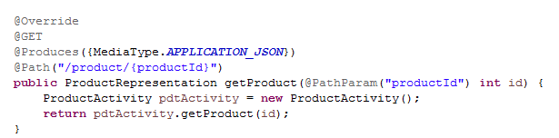
Implementation
Follow ReST design principles to CRUD
Example of the GET method:

Slide 24
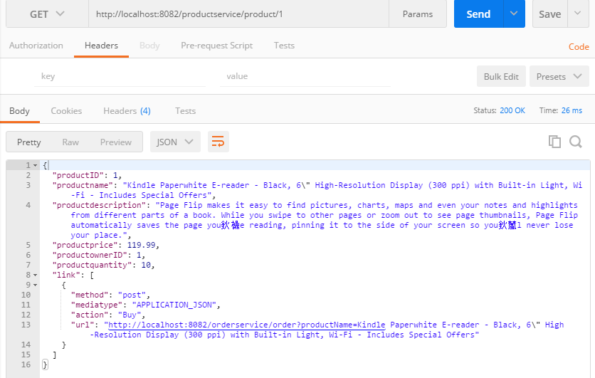
Implementation
Screenshot from postman of get method

Slide 25
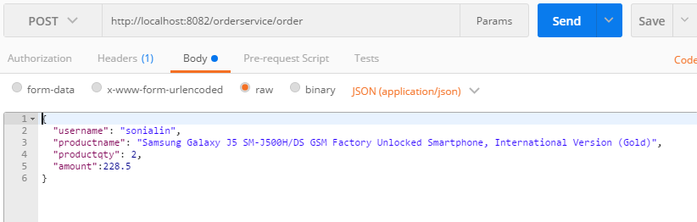
Implementation
Example of the POST method:

Slide 26
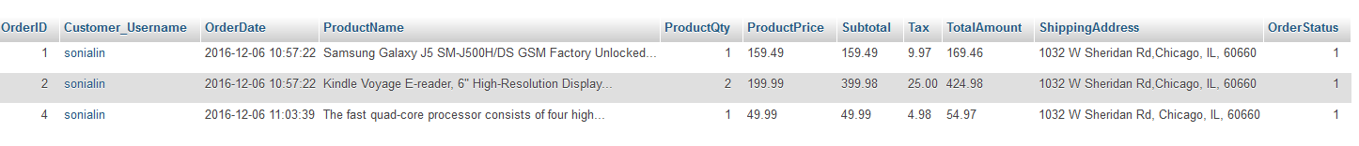
Implementation
Result in database

Slide 27
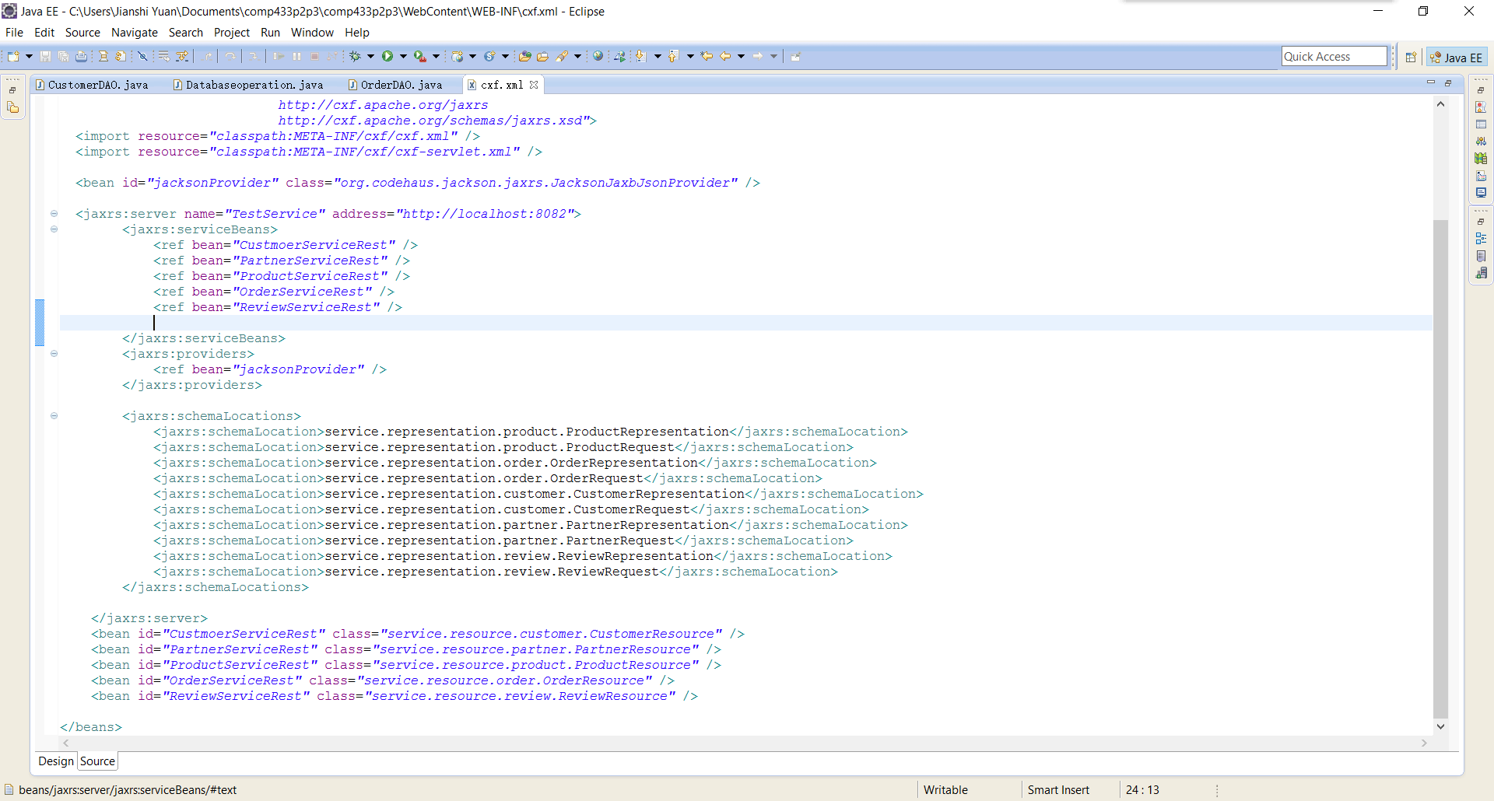
Implementation
Server Configuration

Slide 28
Difficulties and Lessons
Didn’t know how to create a standard layered structure at the beginning, mixed domain layer and DAC layer
Know how to create it in class
Had difficulty to write a post commend and finally figure it out
The most important is to understand what ReST is, how it works and how to develop a ReST program

Slide 29
THANK YOU!

